Slide 1
AWS Partner Network
Let’s Consult

Slide 2
Overview of APN
AWS Partner Network (APN) is a group of external vendors that have received endorsement from AWS regarding their expertise in building and implementing solutions for AWS.
Let’s understand with an example:
Team of 5 people are very good into security aspect of AWS.
They have decided to create a company for consulting organizations to secure their resource.
They registered to become APN
knowledge portal

Slide 3
Two Types
AWS Partners
APN Consulting Partners
APN Technology Partners
knowledge portal

Slide 4
APN Consulting Partner
APN Consulting Partners are professional services firms that help customers of all types and sizes design, architect, build, migrate, and manage their workloads and applications on AWS, accelerating their journey to the cloud.
Let’s understand with an example:
Small Corp has all their servers in the datacenter.
They want to migrate to AWS.
They don’t yet have any expert who can guide them in this process.
Small Corp can opt for services from APN Consulting Partner.
knowledge portal

Slide 5
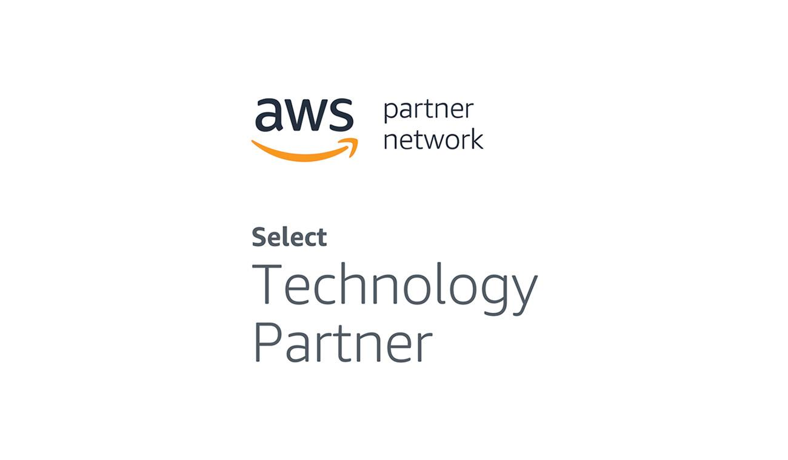
APN Technology Partner
APN Technology Partner refers to organizations that are developing their own products/services that they will deploy on top of AWS to sell it to the customers.
Example:
Trend Micro is one of the APN Technology partners who have their own solution related to Anti-Virus, IPS and others.
knowledge portal

Slide 6
Shared Responsibility Model
Distribution is always good

Slide 7

Own Server Room
knowledge portal

Slide 8
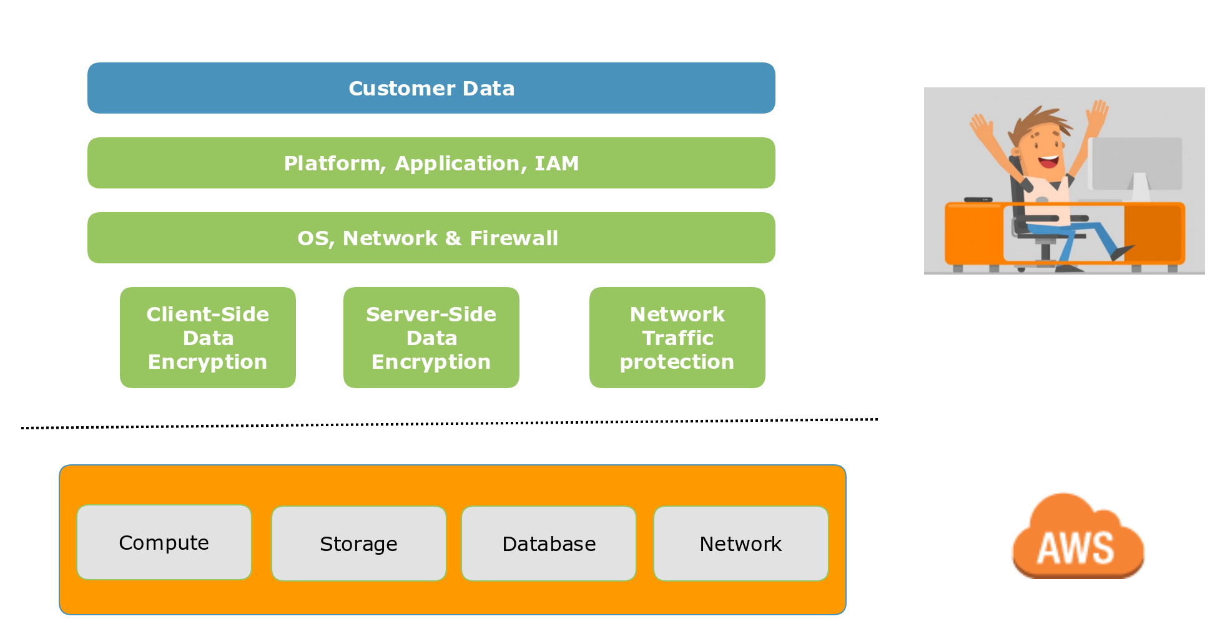
Shared Security Responsibility Model
knowledge portal

Slide 9
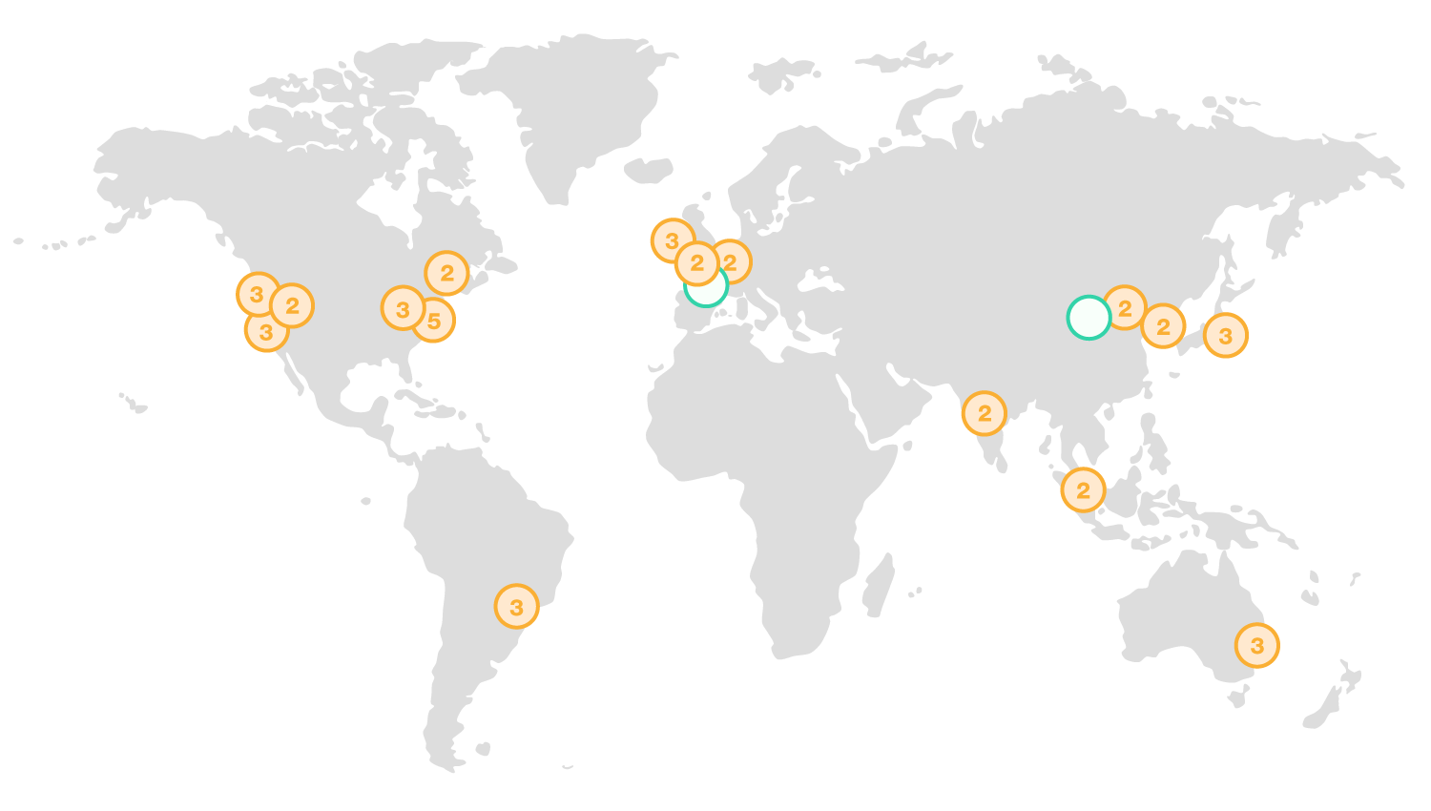
AWS Global Infrastructure
knowledge portal

Slide 10
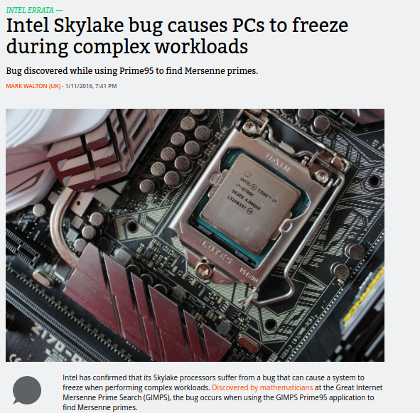
Intel CPU Bug
knowledge portal

Slide 11
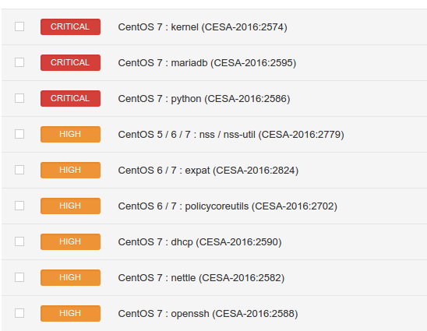
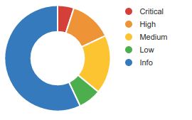
Un-Patched Operating System
knowledge portal

Slide 12



Classification of Shared Responsibility Model
AWS has more than 140+ services available. Each of them are classified into :-
Infrastructure Services
Container Services
Abstract Services
Infrastructure Container Abstract
knowledge portal

Slide 13


Infrastructure Services
Infrastructure-as-Service are ones where organization outsources physical components of Data Center, such as storage, hardware, servers and networking
Example : EC2, EBS, Autoscaling, VPC
knowledge portal

Slide 14
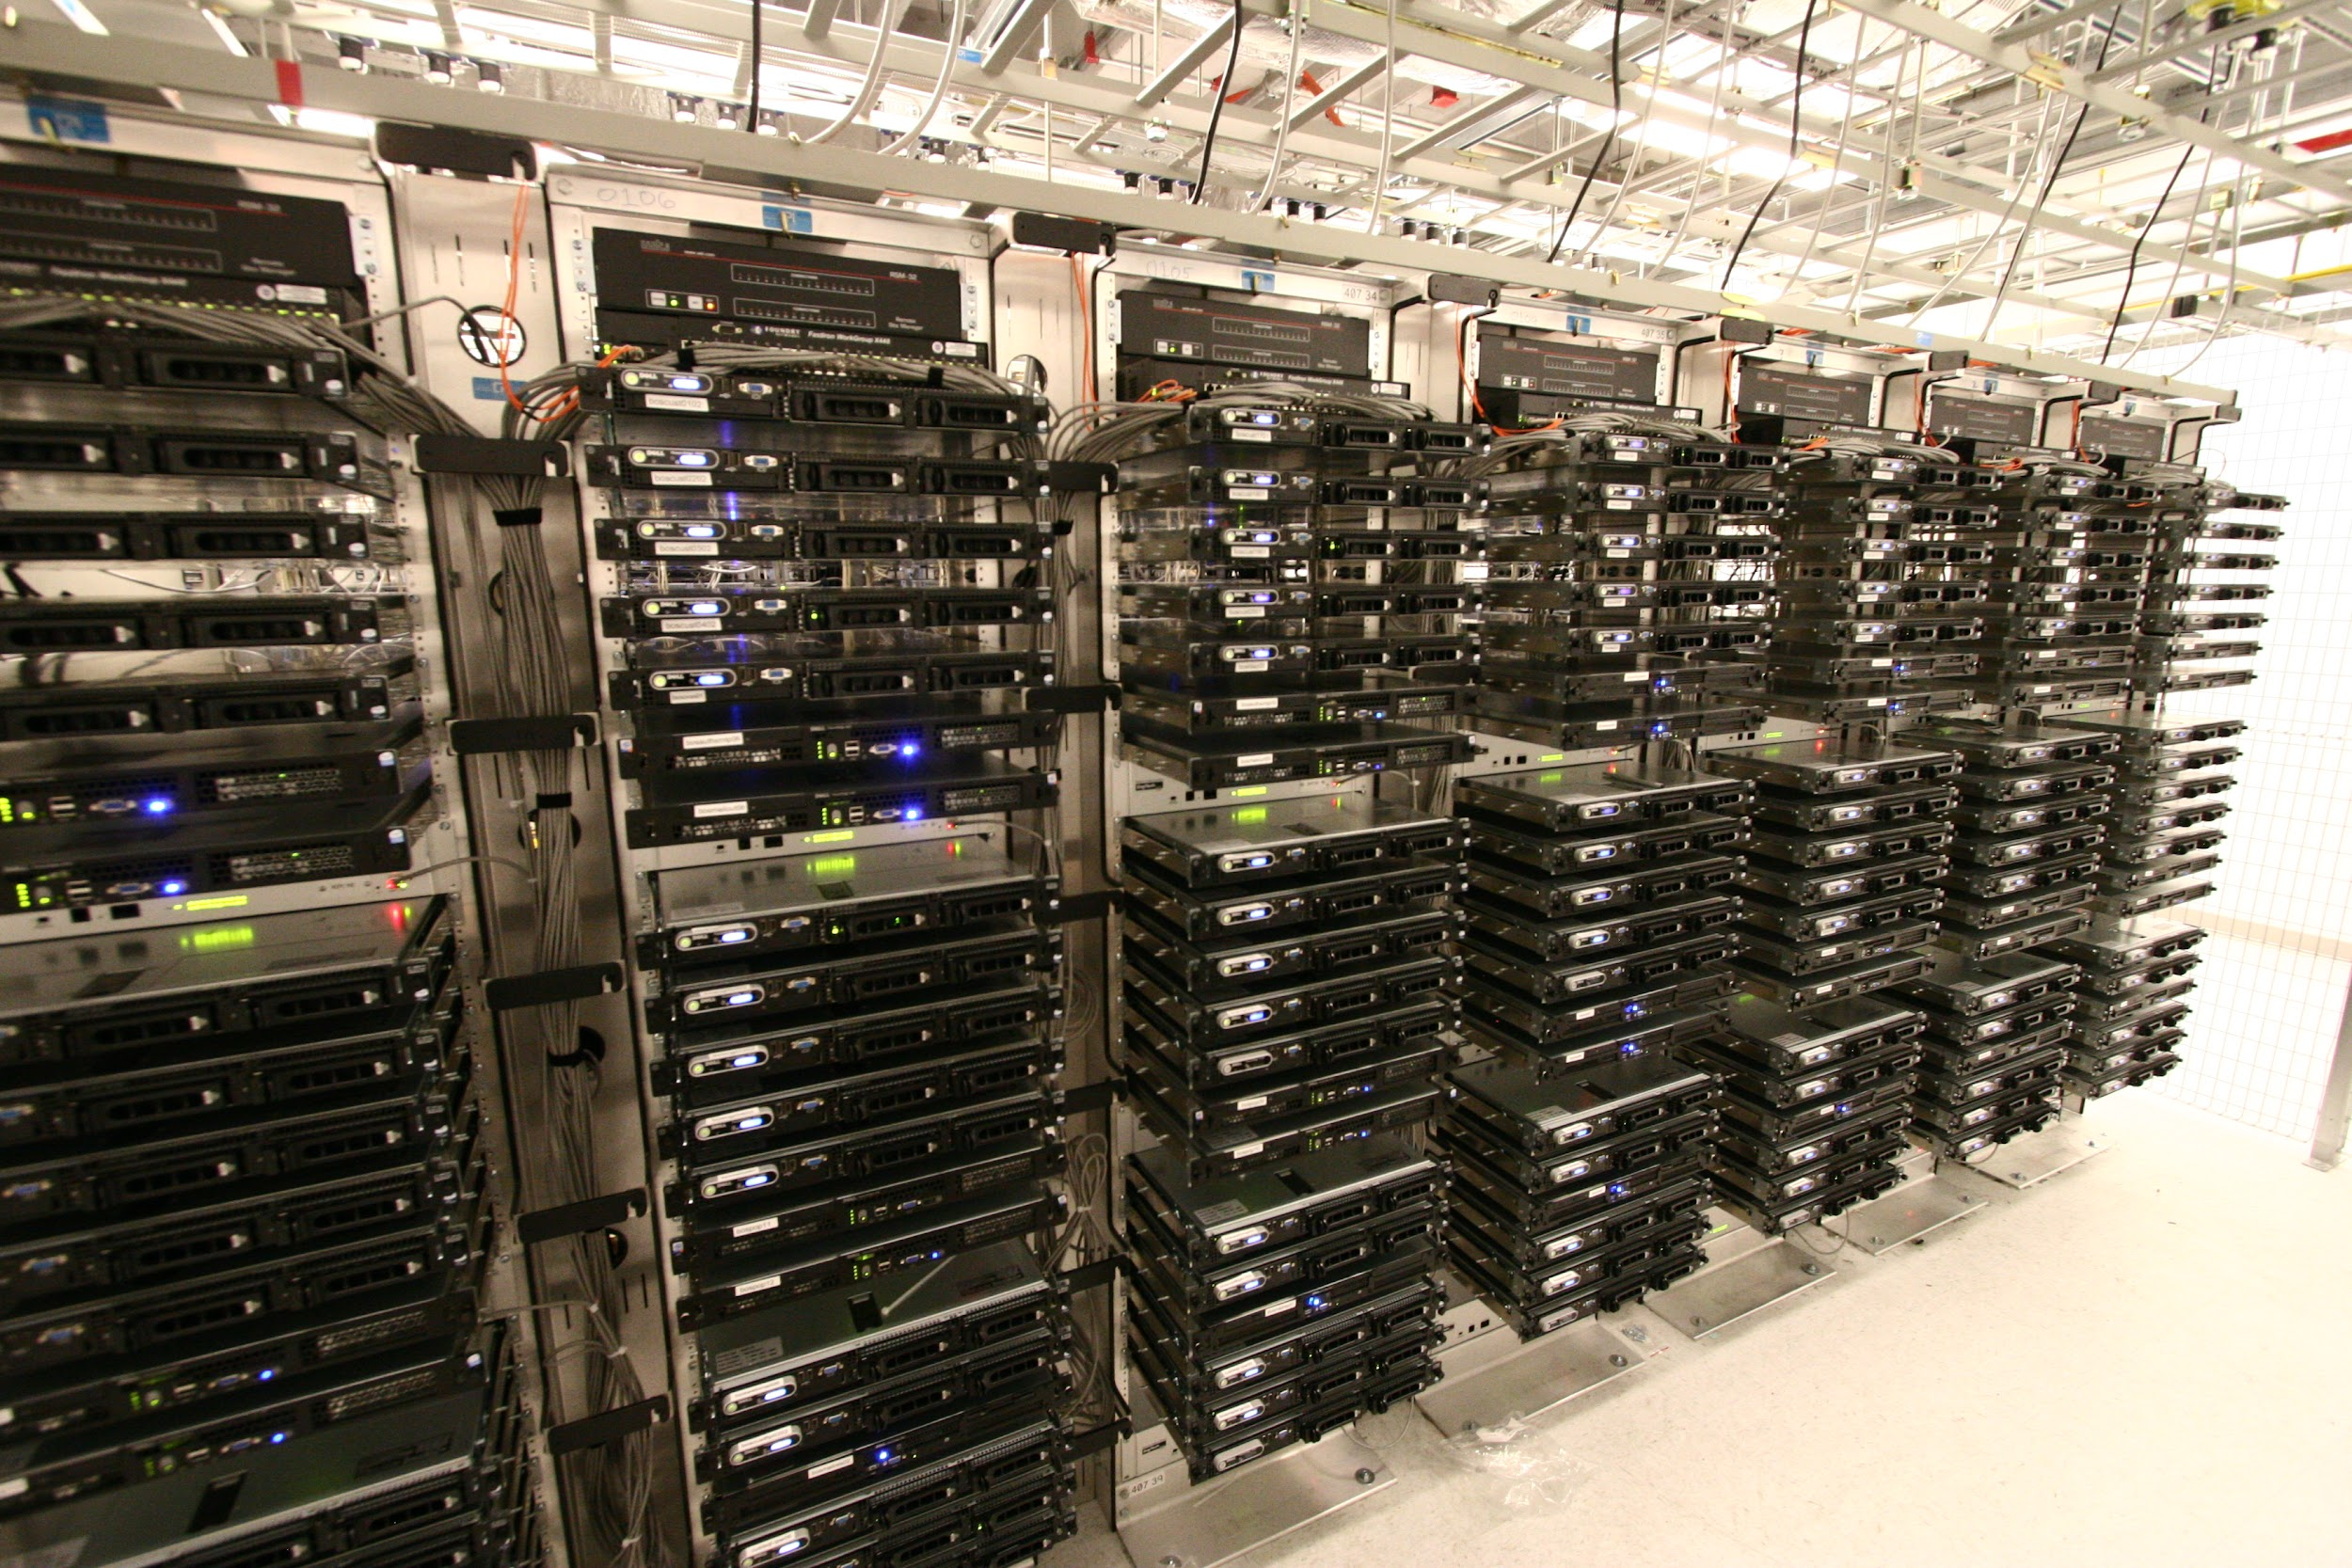
knowledge portal

Slide 15
Infrastructure Services
AWS Foundation Services
Regions, AZ and Endpoints
AWS API Endpoints
Operating System
Encryption of Data
Application
knowledge portal

Slide 16
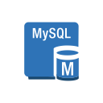

Container Services
Container Services are the one which runs on top AWS Managed EC2 instances.
Here the customers do not manage the OS or platform layer.
Example : RDS, Elastic MapReduce, Elastic BeanStalk.
knowledge portal

Slide 17
Container Services
Foundation 4
Operating System
Backup & Patching
Customer Data
Firewall
Encryption of Data
IAM
knowledge portal

Slide 18


Abstract Services
Abstract Services just provides the management layer to the users.
We can interact with these services via its Endpoints.
Here the customers do not manage the OS or platform layer.
Example : SES, SQS, SNS, S3
knowledge portal

Slide 19
Abstract Services
Foundation 4
Operating System
Application
Backups & Encryption
Data
IAM
knowledge portal

Slide 20
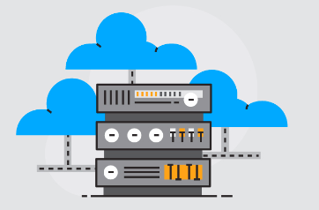
Security Responsibility is Shared
Security Responsibility will always be shared between you and your hosting provider.
The Hosting Provider has to ensure Security OF the Cloud
You have to ensure Security IN the Cloud.
With both the entities doing their job, we can then say that our systems are secured.
knowledge portal

Slide 21
Identity and Access Management
Access Management

Slide 22




Overview of IAM
Identity and Access Management is a framework of policies for ensuring that the proper people in an enterprise have the appropriate access to technology resources.
Rules
John should have full access to all the services
Alice should only have access to EC2
Matt should not have access to any services.
knowledge portal

Slide 23
Simplifying the Architecture
IAM System
Users
Rules
John should have full access to all the services
Alice should only have access to EC2
Matt should not have access to any services.
AWS Resource

Slide 24
AWS Terminology
IAM
IAM Users
IAM Policies
John should have full access to all the services
Alice should only have access to EC2
Matt should not have access to any services.
AWS Resource

Slide 25
IAM User
IAM user is an entity that you create in AWS to represent the person or application that uses it to interact with AWS.
By default, the IAM user does not have any permission associated with it.
knowledge portal

Slide 26
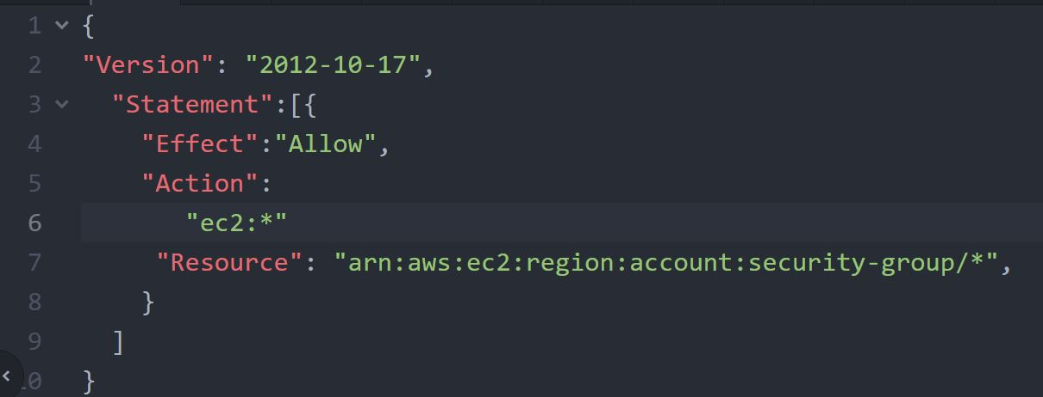
IAM Policy
IAM Policy is an object in AWS that defines the permission of a specific object.
AWS evaluates the policies, and depending on that, the permission is granted or denied.
knowledge portal

Slide 27

IAM Groups
An IAM group is a collection of IAM users.
IAM policy attached to the group is associated with all the users that are part of the group.
IAM Group
IAM Policy
knowledge portal

Slide 28


IAM Role
An IAM role is similar to an IAM user, in that it is an AWS identity with permission policies that determine what the identity can and cannot do in AWS.
IAM Role
IAM Policy
AWS EC2
S3FullAccess
AWS Lambda
knowledge portal

Slide 29
AWS Command Line Interface (CLI)
Access Management

Slide 30
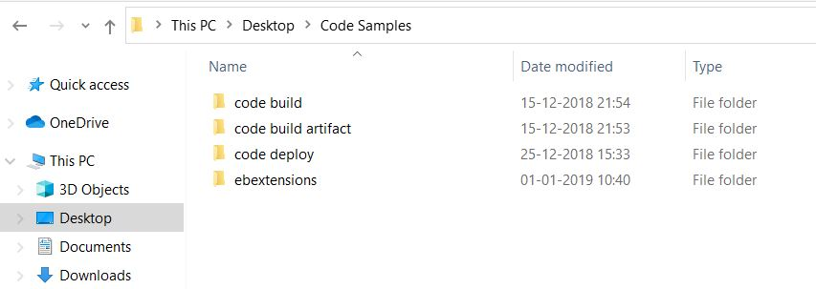
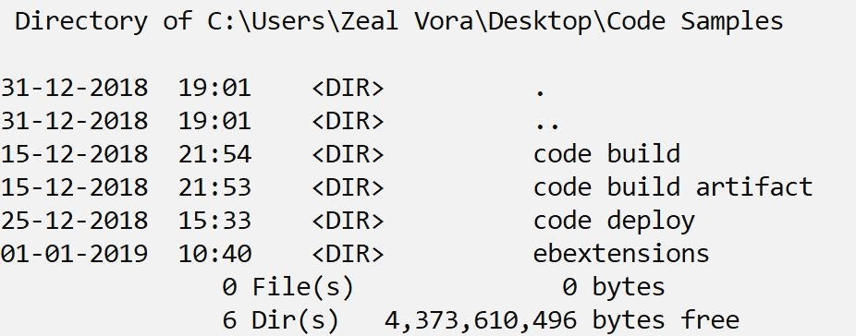
GUI and CLI
GUI Console
CLI
knowledge portal

Slide 31
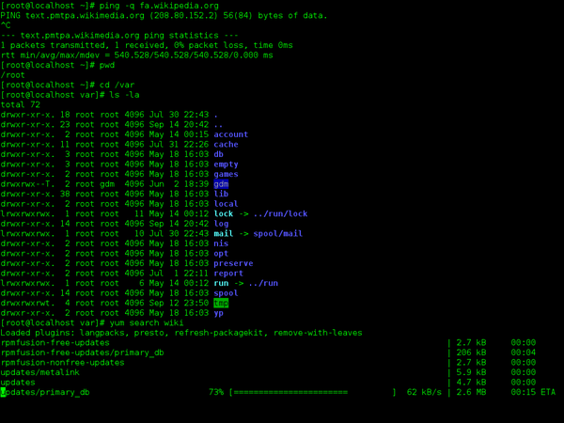
CLI is always faster
Command Line Interface ( CLI ) is way of interacting with the system in form of commands
It is considered as fastest way of doing things in an repeated, automated fashion.
knowledge portal

Slide 32

Simple Use-Case
A new “Security Check System” verifies the security of an EC2 instance
It evaluates the system configuration after logging into the EC2 instance.
It needs Private IP as an Input.
Security Check System
Login via Private IP

Slide 33
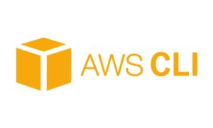
AWS CLI
AWS CLI is used for managing AWS resources from the terminal.
It makes room for automation & make things much more faster.
knowledge portal

Slide 34
AWS CLI Pre-Requisites
There are two primary prerequisites for AWS CLI
AWS CLI Binary
AWS Access Secret Keys OR IAM Role
AWS Platform
Create EC2 Instance
awscli
Need Authentication
knowledge portal

Slide 35
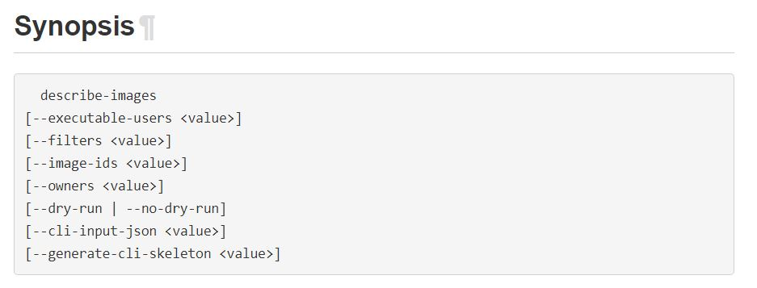
AWS CLI Documentation
There are separate set of documentation available for AWS CLI
These covers the list of all options that can be used while making use of AWS CLI.
knowledge portal

Slide 36
IAM Roles
Access Management

Slide 37



Overview of IAM Role
IAM Role is an entity that contains set of policies and any resource assuming that role will be able to have permissions mentioned in the role.
Assume Role
IAM Policies
EC2FullAccess
S3ReadOnlyAccess
EC2 Instance
IAM Role
Assume Role
IAM User
knowledge portal

Slide 38

Sample Use-Case- No No Scenario
EC2 Instance wants to get data from an S3 bucket.
Access/Secret Keys
AKIBS321sd
s238&#$ak
EC2 Instance
S3 Bucket
knowledge portal

Slide 39
Example - Best Practice
It is recommended to always make use of IAM Role instead of hard coding the AWS Access Keys within EC2 instance / software code.
EC2 Instance
IAM Policies
S3ReadOnlyAccess
knowledge portal

Slide 40
Need of Compliance
Security Compliance

Slide 41
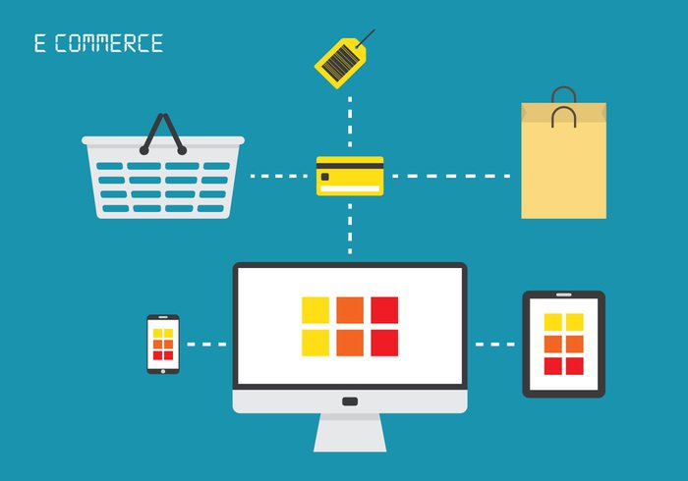


Use Case
knowledge portal

Slide 42
Compliance Program
There are Regulatory Compliance program formed either by Governments or an independent body which defines set of policies and procedures that an organization must follow.
For example :-
PCI DSS ( PCI SSC - VISA, Master, JCB, AE )
HIPAA ( US Government )
RBI PSS ( Reserve Bank of India)
knowledge portal

Slide 43
Compliance Program
Organization needs to be compliant to one the compliance depending on their Business.
For example :-
PCI DSS → ORG that deals with storing, processing or transmitting CHD.
HIPAA → ORG that deals with health care data.
RBI PSS → ORG that deals with Digital Wallets in India
Failure to compliance can lead to legal actions and major penalties.
knowledge portal

Slide 44

It’s great deal to us
All of these compliance are very much related to “Security” of the information.
It means alot to us as a “ Security Professional”.
Lot of organization now has “Compliance Officer” and they hire Security Professionals whose main aim is to help organization conform to various regulatory compliance.
knowledge portal

Slide 45
AWS Artifact
Compliance Time

Slide 46
Understanding AWS Artifacts
The AWS Artifact portal provides on-demand access to AWS' security and compliance documents, also known as audit artifacts.
Lots of AWS services are compliant against various compliance like PCI DSS, HIPAA and others.
If the organization is using certain AWS services, then auditor will ask the organization to show certificate that the service is compliant.
knowledge portal

Slide 47
AWS Config
Overview of Infrastructure Changes

Slide 48
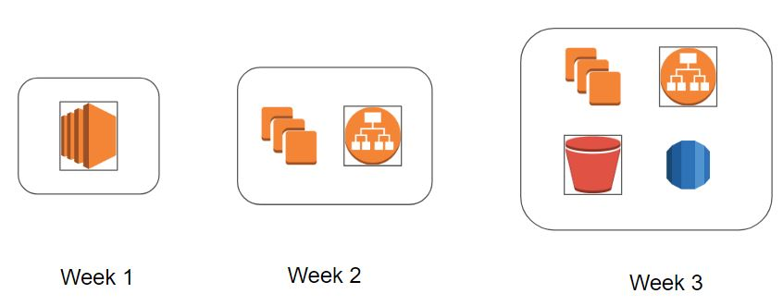
AWS Config - High Level Overview
AWS Config is primarily used to record the resource configuration changes over time.
An EC2 instance was hosting website from past 90 days. Suddenly in last one week, there have been a lot of issues with the requests. What was changed?
knowledge portal

Slide 49
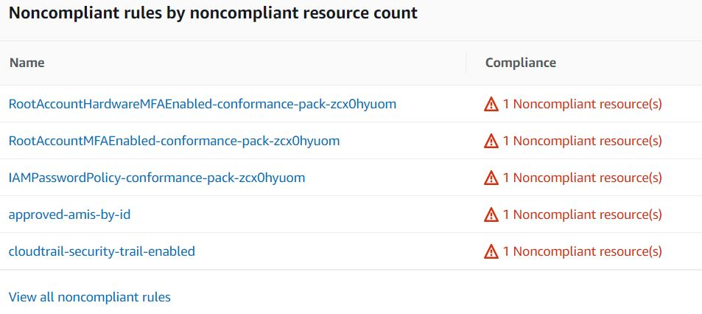
Audit and Compliance
AWS Config comes with large set of rules that can continuously monitor your AWS environment and report the findings.
knowledge portal

Slide 50
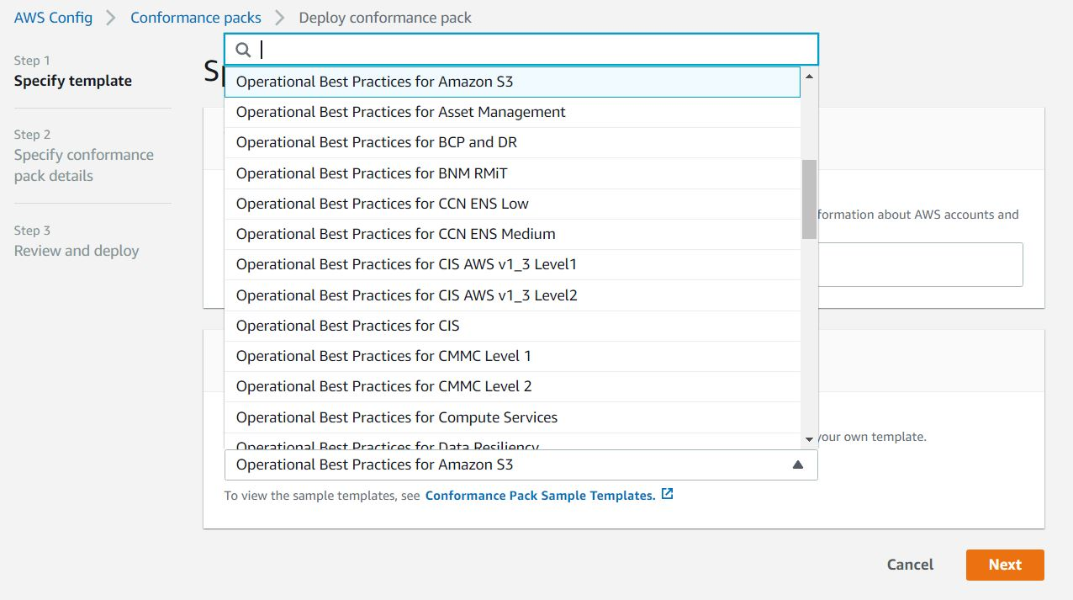
Conformance Packs
A conformance pack is a collection of AWS Config rules and remediation actions that can be easily deployed
knowledge portal

Slide 51
Pricing of AWS Config
You pay $0.003 per configuration item recorded in your AWS account per AWS Region. A configuration item is recorded whenever a resource undergoes a configuration change or a relationship change.
Based on rule evaluation. A rule evaluation is recorded every time a resource is evaluated for compliance against an AWS Config rule.
You are charged per conformance pack evaluation in your AWS account per AWS Region based on the tier below.
knowledge portal

Slide 52
Trusted Advisor
Recommendations are always good

Slide 53
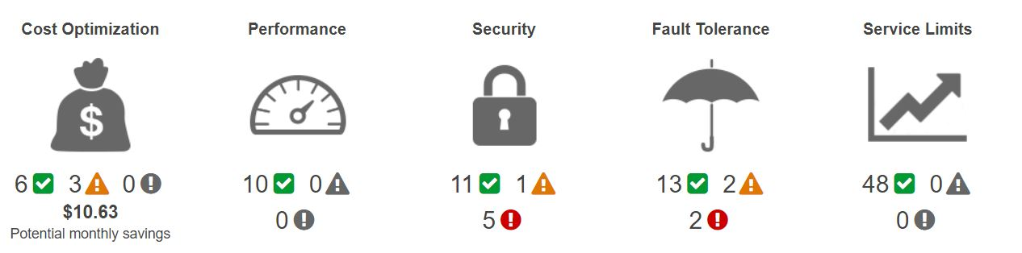
What is Trusted Advisor ?
AWS Trusted Advisor analyzes your AWS environment and provides best practice recommendations in five major categories:
knowledge portal

Slide 54
Trusted Advisor Check Categories
Categories | Description
Cost optimization | Recommendations that can potentially save you money.
Performance | Recommendations that can improve the speed and responsiveness of your applications.
Security | Recommendations for security settings that can make your AWS solution more secure.
Fault tolerance | Recommendations that help increase the resiliency of your AWS solution.
Service limits | Checks the usage for your account and whether your account approaches or exceeds the limit for AWS services and resources.
knowledge portal

Slide 55
CloudTrail
Let’s Monitor Everything !

Slide 56
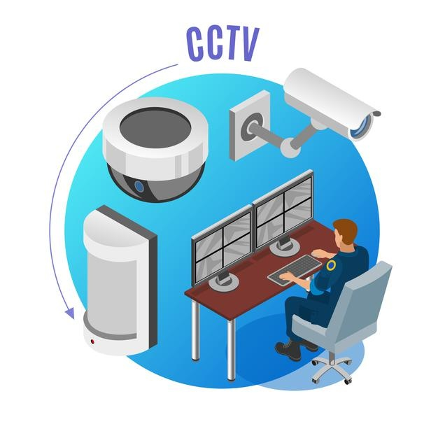
Importance of Recording Everything
Installing video surveillance systems allows us to monitor activities round the clock and provides lots of benefits, some of these include:
Deterring Criminals
Helps in Investigation.
Regular monitoring of activities.
Insurance Benefits.
knowledge portal

Slide 57
Recording at AWS Level
It is VERY important for organizations to record the activities that happen within the Infrastructure as well as the servers.
Example Auditor Question :-
Show me what did Anne did on 3rd of January 2017 between 10 AM to 2 PM.
User | Action | Time
James | Logged In | 3:50 PM
Anne | Modified SG | 7:30 PM
Susan | New EC2 | 11:00 PM
knowledge portal

Slide 58


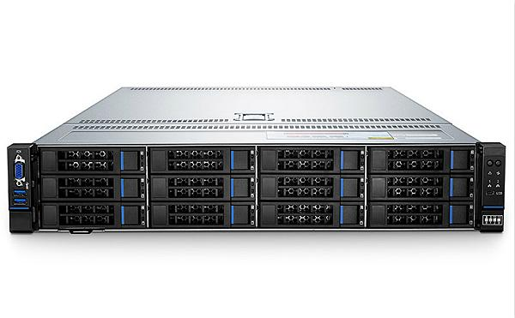
Tools for Recording
Depending on the type of resource you use, the tools for recording might also change.
Record AWS events
CloudTrail
auditd
Record Linux events
knowledge portal

Slide 59
Denial of Service
Attack difficult to mitigate

Slide 60
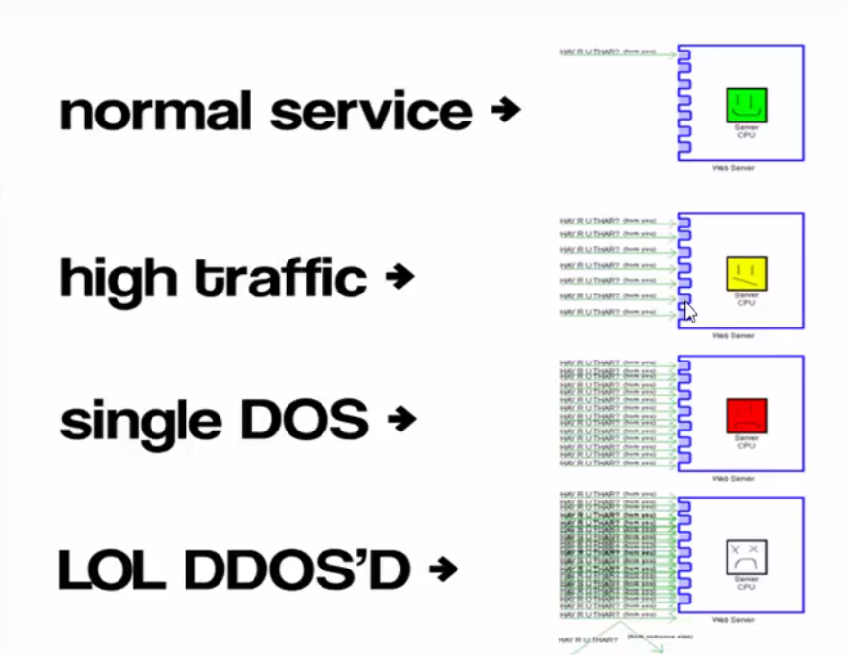
knowledge portal

Slide 61

DOS and DDoS are part and parcel of servers life
DOS and DDoS attacks are very common attack vectors used nowadays to bring down the servers or flood the network.
The reason why they are so successful is because of ease of ability to launch the attack and most of the protection mechanisms are based on expensive hardware.
knowledge portal

Slide 62
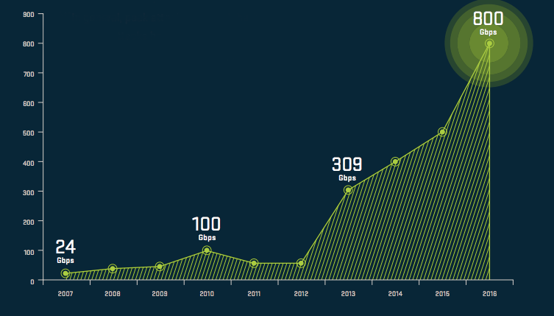
DDOS attacks are going really big!
knowledge portal

Slide 63
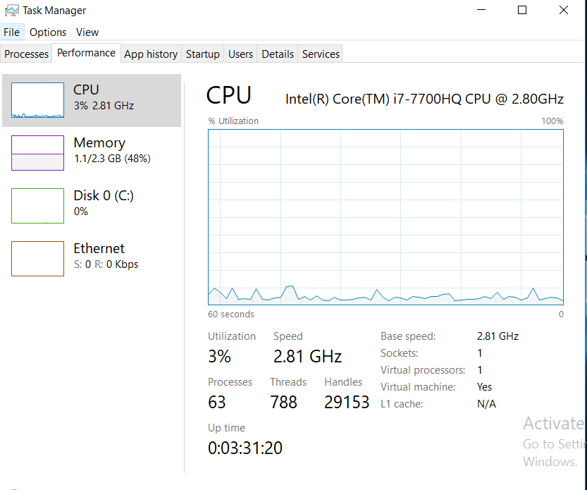
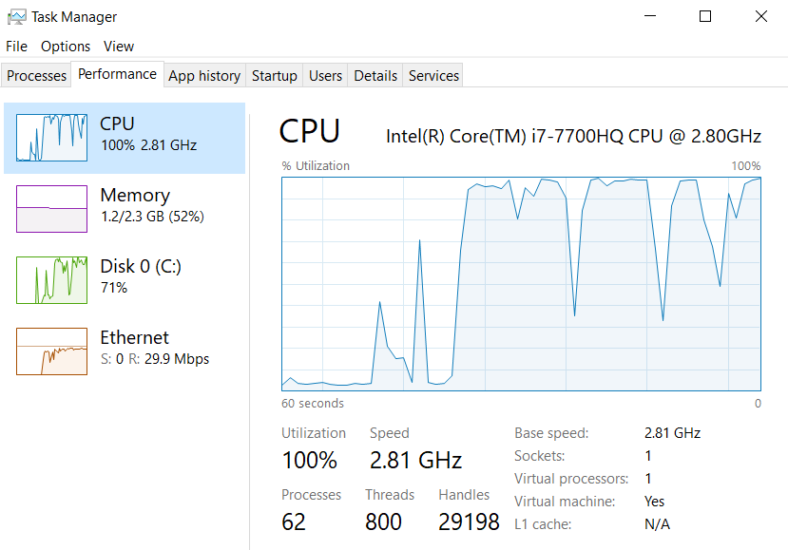
Before vs After (DOS Attack)
knowledge portal

Slide 64
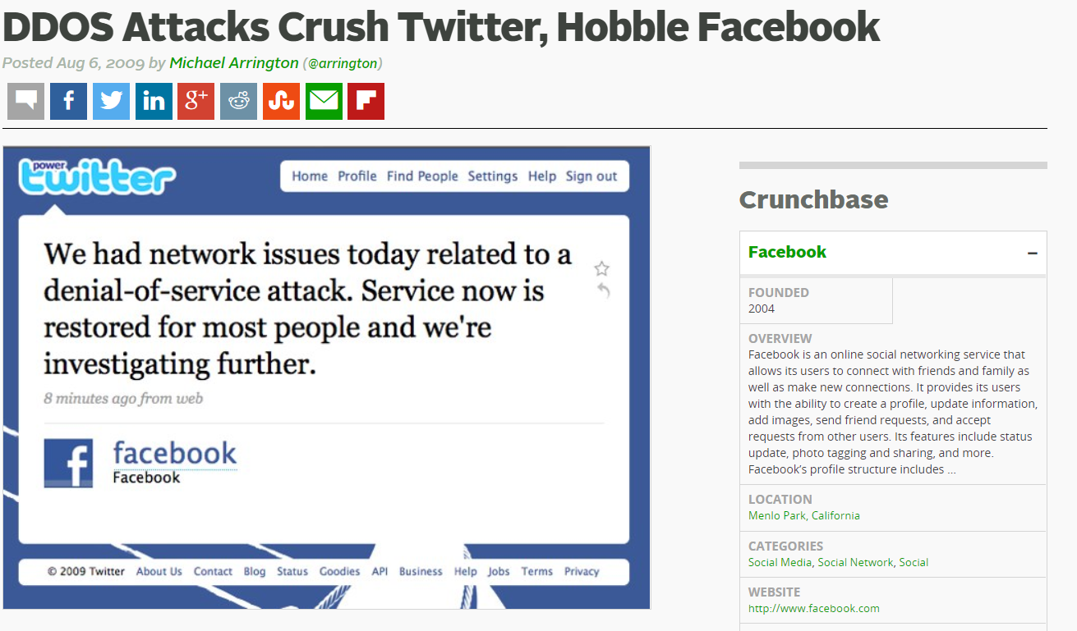

Slide 65
AWS Shield
DDoS Protection

Slide 66
Understanding AWS Shield
AWS Shield is a managed Distributed Denial of Service (DDoS) service that safeguards the workloads running on AWS against DDoS attacks.
There are two tiers of AWS Shield:
Shield Standard
Shield Advanced
knowledge portal

Slide 67
Understanding AWS Shield
AWS Shield standard provides basic level protection against most common network and transport layer DDoS attacks.
For a higher level of protection, we can subscribe to the Shield Advanced. Shield Advanced protects against large and sophisticated DDoS attacks with near-real-time visibility into the attacks that might be occurring.
AWS Shield Advanced also gives customers 24x7 access to the AWS DDoS Response Team (DRT) during ongoing attacks.
knowledge portal

Slide 68
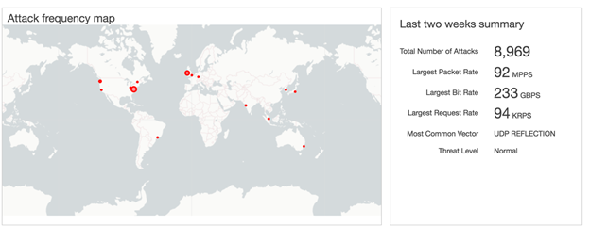
AWS Shield Costs and Credits
AWS Shield Advanced costs 3000$ per organization and requires Business or Enterprise Support.
One interesting part about AWS Shield Advanced is that during the attack, if your infrastructure has scaled, AWS will return you the amount occurred during scaling in the form of credits. This is also referred to as Cost protection.
knowledge portal

Slide 69
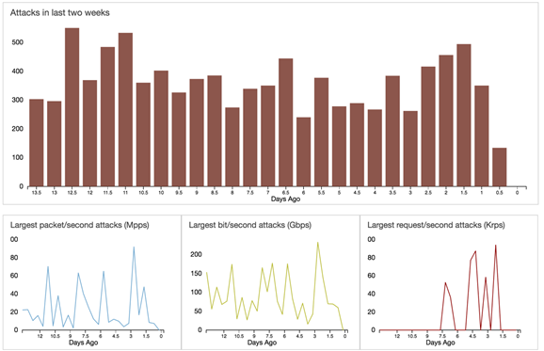
AWS Shield Dashboard
knowledge portal

Slide 70
Direct Connect
Let’s Route Centrally

Slide 71




Customer to VPC
knowledge portal

Slide 72

Packets travels via Hops

Slide 73

Challenges
Internet is a good option if amount of traffic is within a certain limit.
There are always latencies which can also be involved.
Many of the organization have hybrid architecture : DataCenter + AWS
In such cases, latency can cause major challenges for the application

Slide 74
Introducing DX
In order to solve this challenge, AWS introduced Direct Connect.
AWS Direct connect let’s customer establish a dedicated direct network connection between the client’s network and one of the direct connect locations.

Slide 75
Benefits of DX
Having direct connection between customer’s datacenter to AWS, brings tremendous amount of benefits, some of them includes:
i) Consistent Network Performance:
ii) Reduces our bandwidth costs
iii) Private connectivity to our AWS VPC

Slide 76
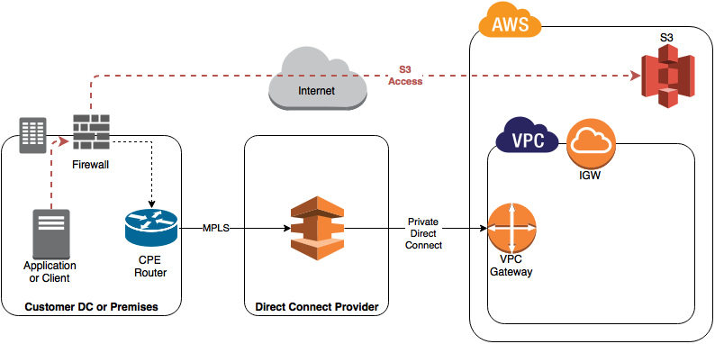
Architecture of DX
knowledge portal

Slide 77
Dealing with Security Breach AWS
Let’s Consult

Slide 78
Overview of Security Breach
Security Breach can happen at various levels.
Some of the examples can be found below:
AWS Access/Secret Keys are leaked.
EC2 instance is hacked.
S3 buckets data is leaked (improper configurations)
Security Breaches are fairly common in organizations.
knowledge portal

Slide 79
Dealing with Security Breach
There are certain actions that customers can taken in-case of security breach.
Change your AWS account root user password.
Respond to any notifications you received from AWS Support.
Rotate and delete all root and AWS Identity and Access Management (IAM) access keys.
Delete potentially compromised IAM users, and change the password for all other IAM users.
Delete any resources on your account you didn't create, such as EC2 instances and AMIs, EBS volumes and snapshots, and IAM users.
knowledge portal

Slide 80
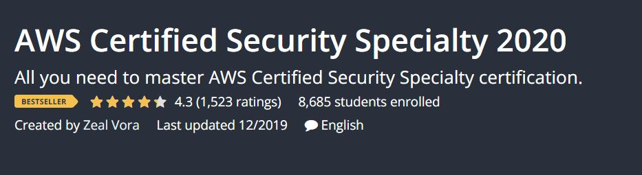
Love Working In This Area?
Security is an great area with interesting workloads.
If you love to learn more about AWS Security join our AWS Security Specialty video course.
knowledge portal

Slide 81
AWS Abuse Reports
Stay within Acceptable Use Policy

Slide 82

Acceptable Usage Policy
Acceptable usage policy or fair use policy is a set of rules applied by the owner to the service user.
Acceptable Use Policy for Rental Apartments:
No Loud Music
No Pet Animals.
No Plants
knowledge portal

Slide 83
AWS Acceptable Use Policy
You may not use, or facilitate or allow others to use, the Services or the AWS Site:
for any illegal or fraudulent activity;
to violate the rights of others;
to violate the security, integrity, or availability of any user, networks
to threaten, or actively encourage violence, terrorism, or other serious harm
knowledge portal

Slide 84
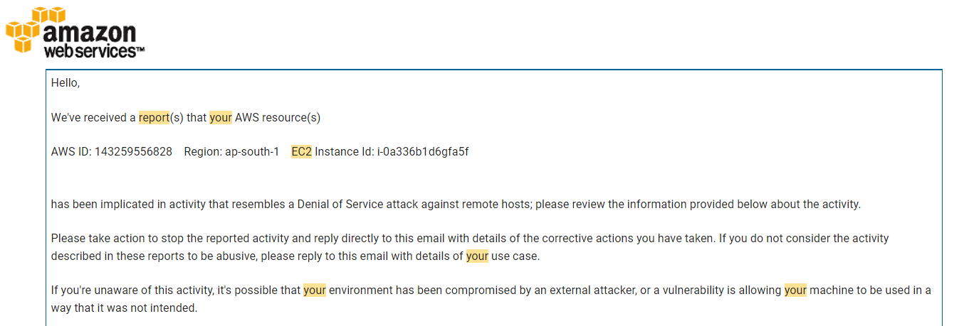
What is Abuse Report ?
AWS sends abuse report to customers when their AWS resources are being used for abusive purposes.
knowledge portal

Slide 85
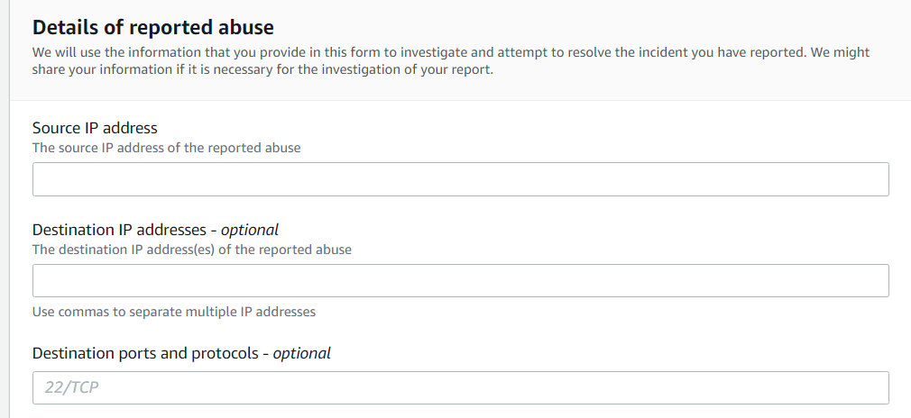
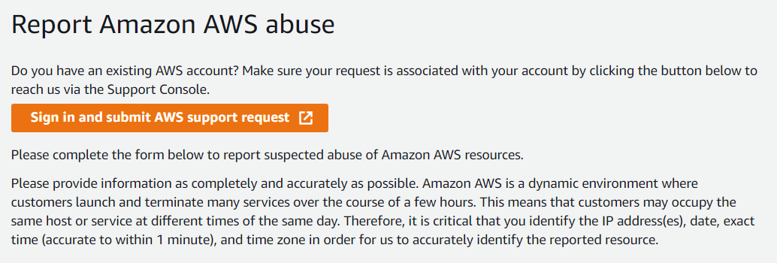
Who raises abuse complaint ?
Abuse Complaint can directly be filed by clients who are getting affected.
If you are receiving some suspected unknown traffic from AWS resource, you can file Abuse complaint in the “Report Amazon AWS Abuse Form”.
knowledge portal

Slide 86
Responding to AWS Abuse Reports
If you receive an abuse notice from AWS, do the following:
Review the abuse notice to see what content or activity was reported. Logs that implicate abuse are included along with the abuse report, as provided by the reporter.
Reply directly to the abuse report and explain how you're preventing the abusive activity from recurring in the future.
If you don't respond to an abuse notice within 24 hours, AWS might block your resources or suspend your AWS account.
knowledge portal

Slide 87
Amazon Machine Image
Let’s Image

Slide 88

Overview of AMI
Amazon Machine Image (AMI) is the master image from which new EC2 instances can be launched.
Let’s understand with an example:
Security Hardening
Configure SELinux
Configure firewalld
Install IPS agent
Configure Auditd
Create Security user
Amazon Linux
Hardened Amazon Linux
knowledge portal

Slide 89
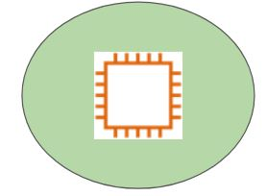
Hardened AMI
EC2 Instances
Hardened Amazon Linux
Prod AWS Account
knowledge portal

Slide 90
Amazon Macie
Machine Learning based Security

Slide 91
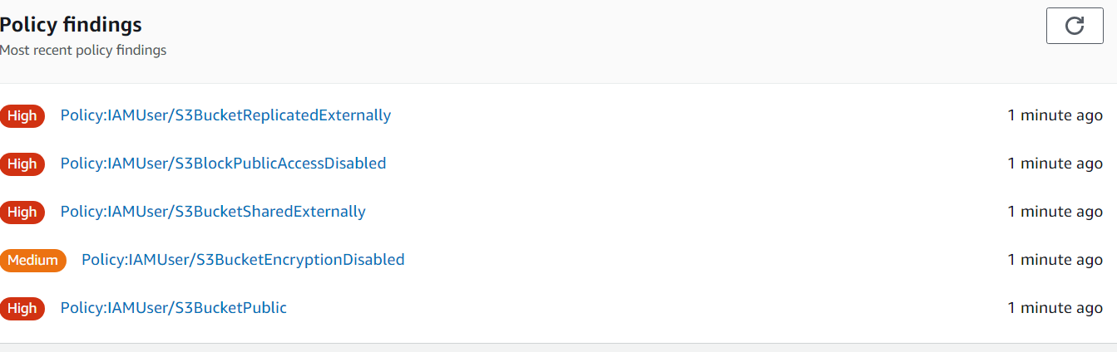
Core Feature of Macie
S3 might contain sensitive information like PII data, database backups, SSL private keys and various others.
Amazon Macie makes use of machine learning to identify sensitive data stored in AWS.
knowledge portal

Slide 92
Vulnerability, Exploit, Payload
Ethical Hacking Terminology

Slide 93
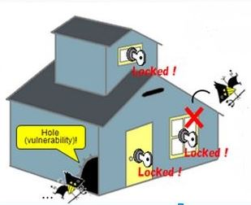
The simple house terminology
knowledge portal

Slide 94
The Answers
Vulnerability :- Hole on the Side of the House
Exploit :- The Robber
Payload :- What Robber does inside the house
knowledge portal

Slide 95
Security Terminology
Vulnerability :- Bad Software Code
Exploit :- Program that exploits code to get inside.
Payload :- Stealing Data, Ransomwares etc.
knowledge portal

Slide 96
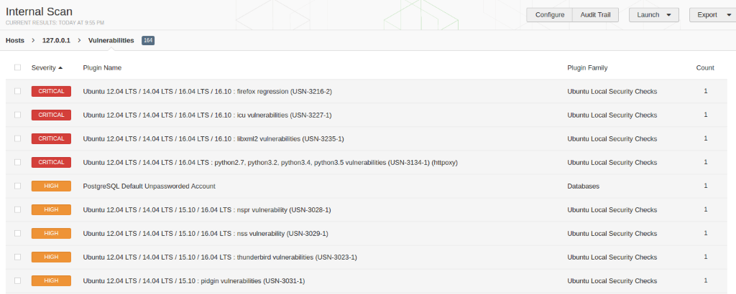
Scan Result of Vulnerability Scanners
knowledge portal

Slide 97
AWS Inspector
Vulnerability Scanner

Slide 98



Basics of AWS Inspector
AWS Inspector is similar to a vulnerability scanner which will scan the system for specific vulnerabilities and provide the results.
It relies on the agent installed on the server to scan the server.
Scan
EC2
SSM Agent
Inspector
knowledge portal

Slide 99
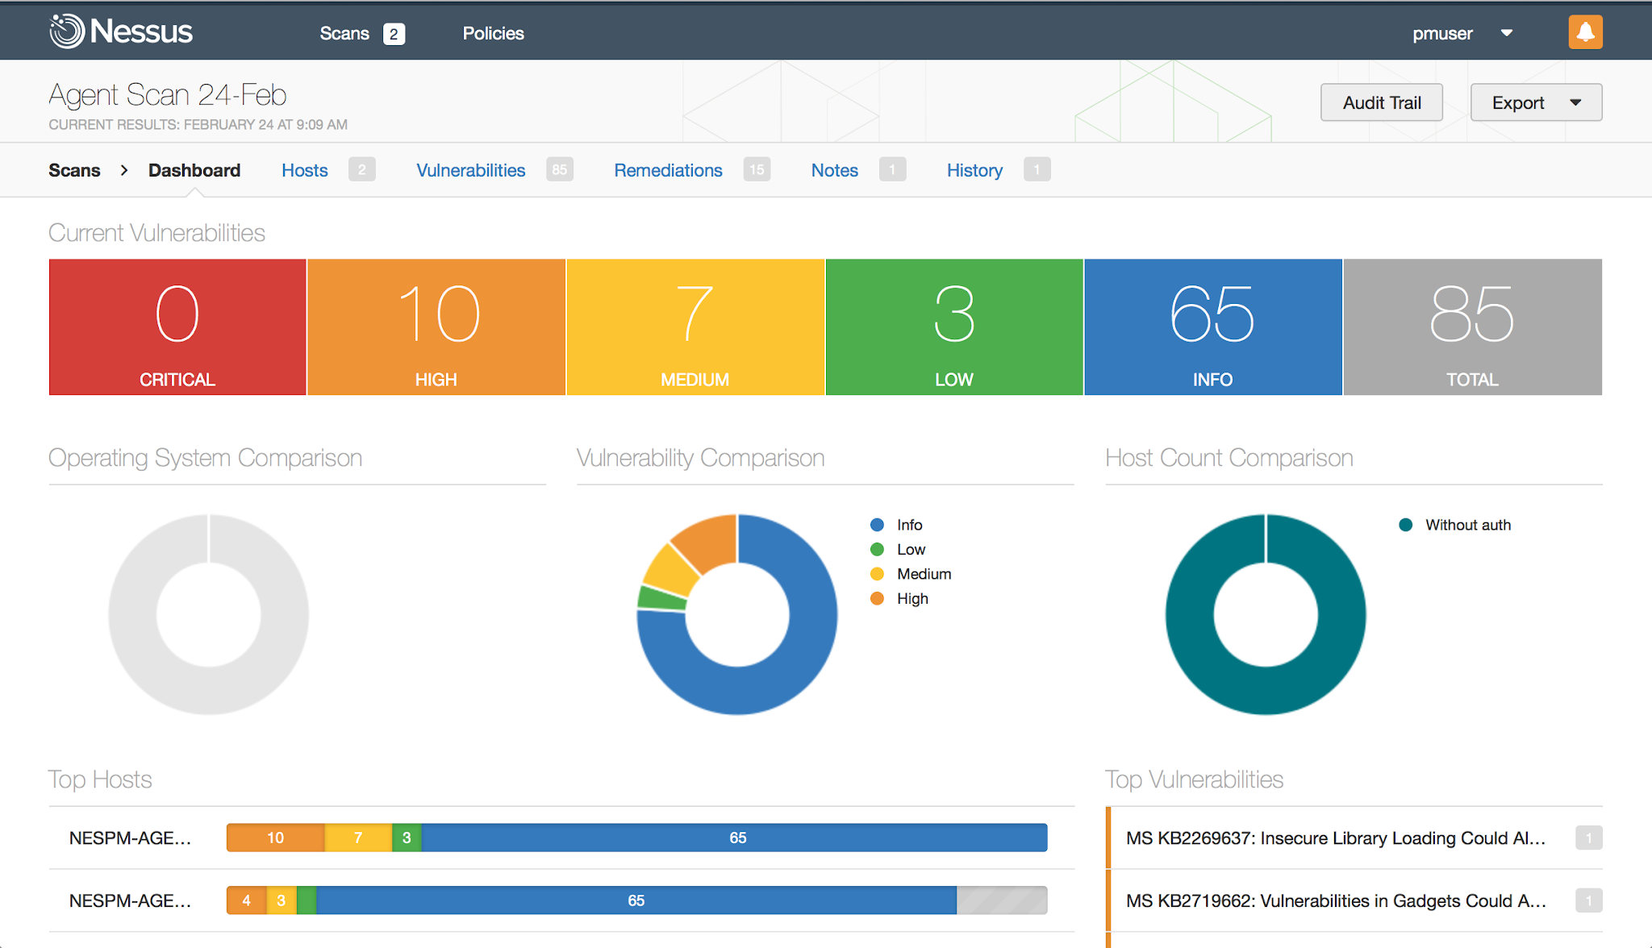
Similar to Nessus
knowledge portal

Slide 100

Supported Scans
Amazon Inspector gives you the flexibility to enable either EC2 scanning or ECR container image scanning, or both.
Scan EC2
EC2
Inspector
Scan ECR
ECR
knowledge portal

Slide 101
Amazon Athena
Query Logs from S3

Slide 102



Getting the basics right
Amazon Athena is service that allows us to analyze various log files from a data source using standard SQL
SQL Query
Analyze Data
Users
Athena
S3 Bucket
knowledge portal

Slide 103
Approach Before Athena
You have CloudTrail logs in S3 and you want to see who has logged in, in the past 10 days.
Create EC2 instances.
Deploy monitoring stack like Splunk, ELK or others.
Add the data source from S3 to import CloudTrail logs.
Begin Analyzing.
knowledge portal

Slide 104
Patching Activity
Let’s Analyze

Slide 105
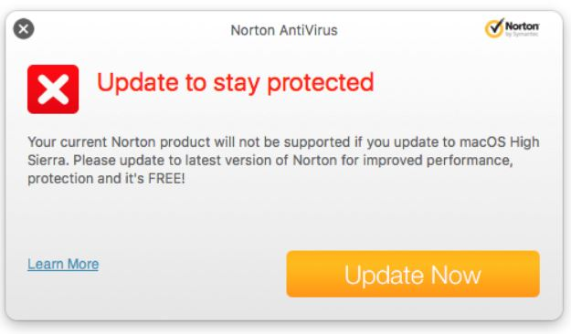
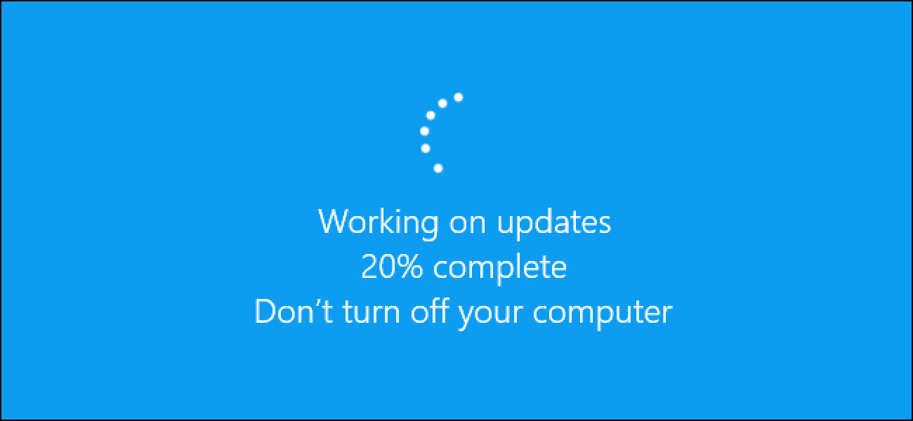
Simple Use-Case - Anti-Virus
When you install an antivirus in your laptop, it receives regular updates to detect newer virus signatures.
knowledge portal

Slide 106
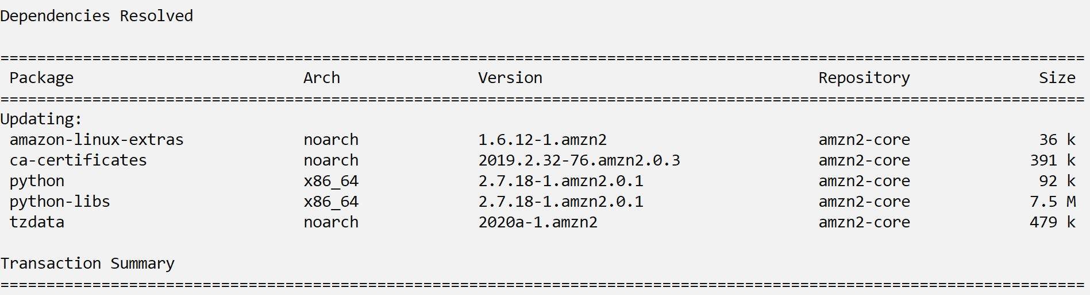
Updates for Servers
Even for Linux Servers, there are new updates that are released regularly.
It is important to keep up with the latest updates.
knowledge portal

Slide 107
Important Pointers - Shared Responsibility
Updates = Patching
Under Shared Responsibility model, depending on the service, the responsibility for patching differs.
Services | Responsibility
EC2 Instances | Customer
DynamoDB | AWS
RDS | AWS [Customer enables the settings]
knowledge portal

Slide 108
VPC Flow Logs
Logs are Awesome

Slide 109
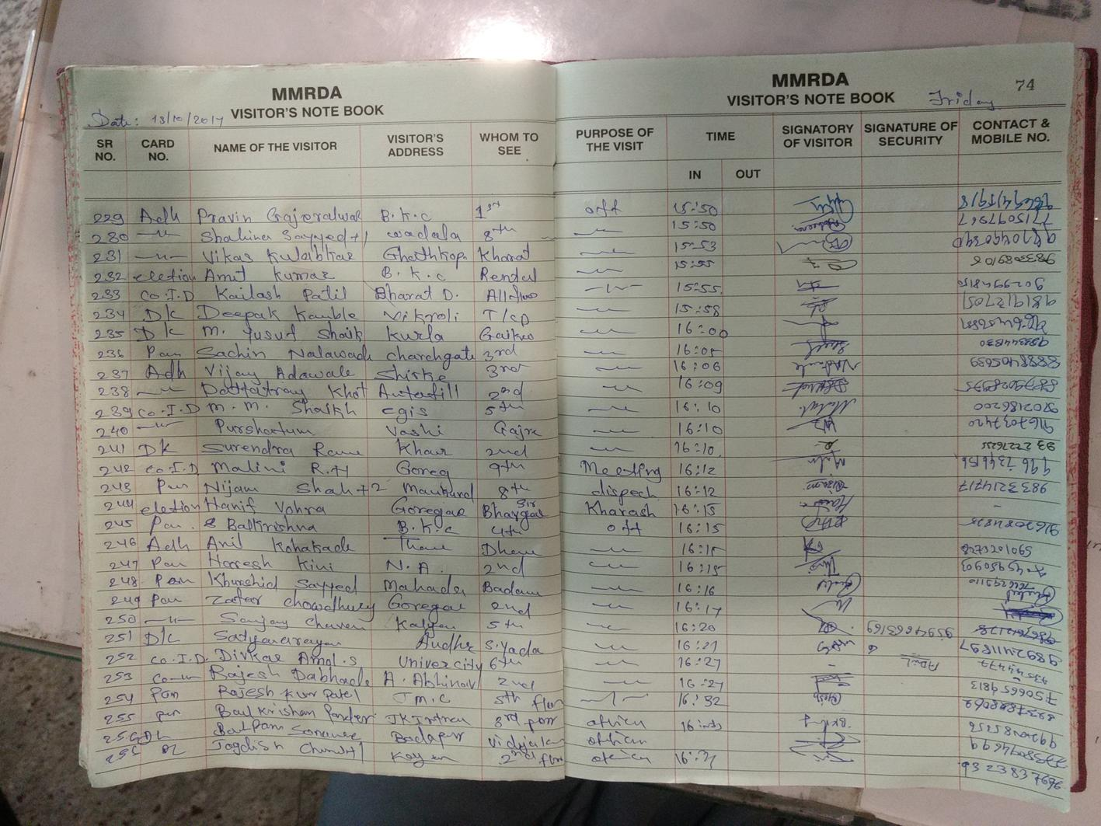
Simple Analogy - Visitor Register
In many of the societies across India, whenever a visitor visits, they first have to fill in their information in the visitor register.
Some of the information includes:
Name
Source Place.
Destination Place.
Entry and Exit Date/Time
Purpose of Work
knowledge portal

Slide 110



Comparing Analogy with AWS Environment
Even in AWS, there can be thousands of users across the world who might be visiting your environment.
Genuine
IP : 10.0.5.57
EC2-1
EC2-2
EC2-N
Hackers
IP : 112.20.50.60
knowledge portal

Slide 111

VPC Flow Logs
VPC Flow Logs is a feature that enables you to capture information about the IP traffic going to and from network interfaces in your VPC.
Visitor Register
VPC Flow Log
knowledge portal

Slide 112
Capture Information Scope
The scope of the VPC Flow logs:
Record the traffic information that is visiting the resource (eg EC2)
Record data about resource connecting to which outbound endpoint.
10.77.2.50 → EC2 Instance
EC2 Instance → 192.168.0.5
knowledge portal

Slide 113
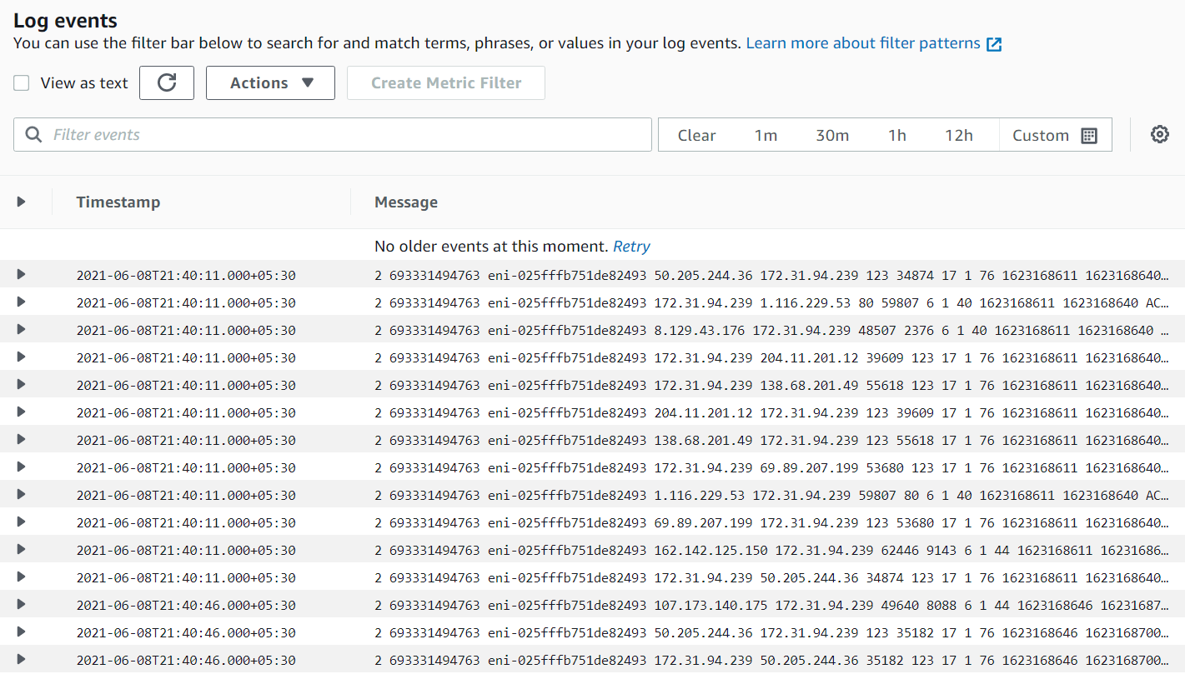
knowledge portal

Slide 114
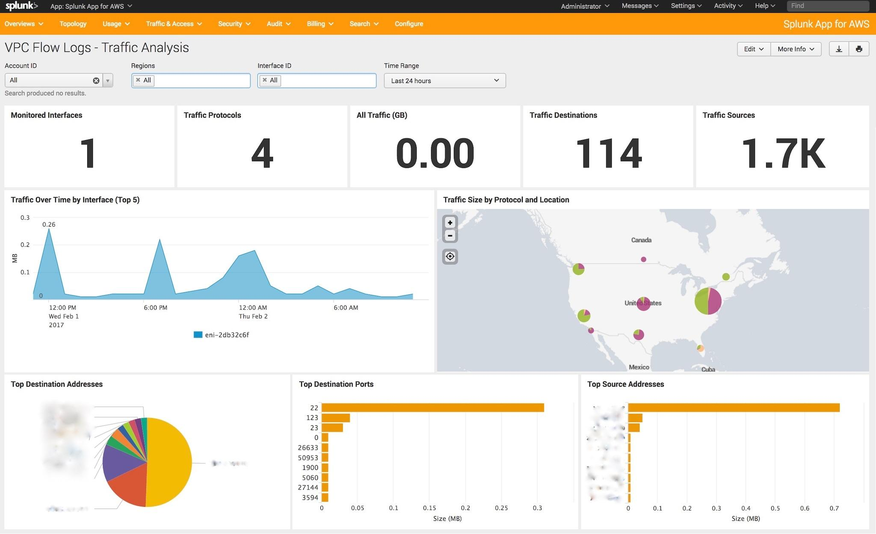
Dashboards Built using VPC Flow Logs Data
knowledge portal

Slide 115
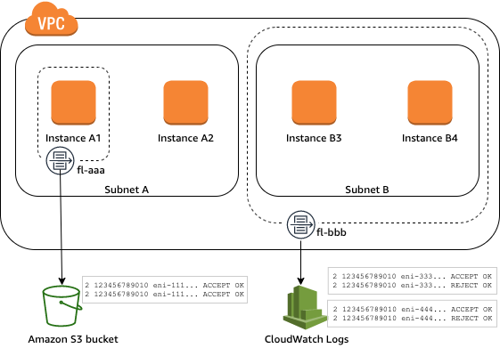
Interface Level Flow Logs
VPC Flow Logs captures traffic at an interface level.
Flow logs do not capture real-time log streams for your network interfaces.
knowledge portal

Slide 116
High-Level Flow Logs Format
version - The VPC Flow Logs Version
account-id - AWS Account ID
interface-id - The network interface id
srcaddr - The source address
destaddr - Destination Address
src port - Source Port
dest port - Destination Port
protocol - The protocol number
packets - Number of packets transferred
bytes - Number of bytes transferred
start - Start time in unix seconds
end - End time in unix seconds
action - ACCEPT or REJECT
log status - Logging status of flow log
2 7742829482 eni-4d788e3d 115.73.149.218 10.0.5.157 12053 23 6 2 88 1485439809 1485440090 REJECT OK
knowledge portal

Slide 117
Type of Traffic Not Logged
Flow logs do not capture all IP traffic. Some of these include:
Traffic generated by instances when they contact the Amazon DNS server. If you use your own DNS server, then all traffic to that DNS server is logged.
Traffic generated by a Windows instance for Amazon Windows license activation.
Traffic to and from 169.254.169.254 for instance metadata.
DHCP traffic.
knowledge portal

Slide 118
Security Hub
Centralized Security Hub

Slide 119
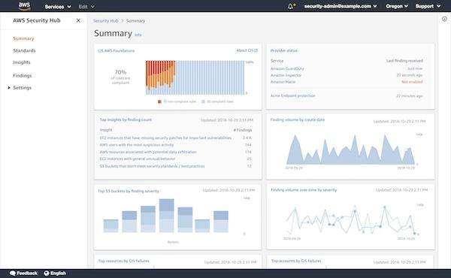
Overview of Security Hub
AWS Security Hub gives you a comprehensive view of your high-priority security alerts and compliance status across AWS accounts.
AWS Guard Duty
Security Hub
AWS Inspector
AWS Macie
knowledge portal

Slide 120
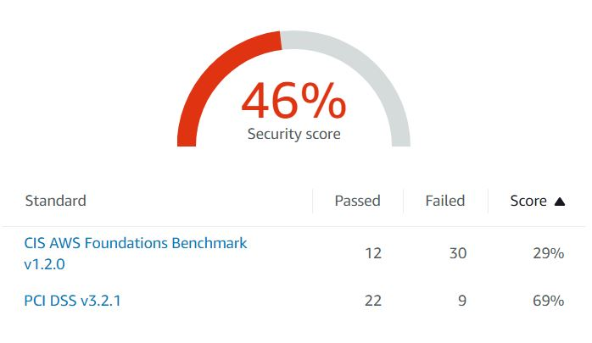
Supported Compliance Standard
AWS Security Hub also has ability to generate its own findings by running automated and continuous checks against the rules in a set of supported security standards.
Following Standards are supported:
CIS AWS Foundation
PCI DSS
knowledge portal

Slide 121
AWS Systems Manager
Interesting Set of Services

Slide 122
Overview of Systems Manager
AWS Systems Manager is a group of services which allows customers to have a better visibility and control of the infrastructure.
Run Command
Systems Manager
Parameter Store
Sessions Manager
Patch Manager
knowledge portal

Slide 123
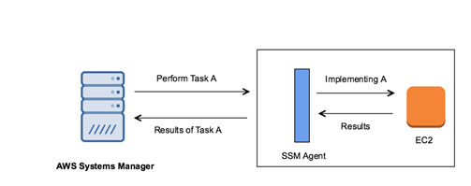
High Level Overview
knowledge portal

Slide 124
Systems Manager - Parameter Store
Not hardcoding the secrets

Slide 125
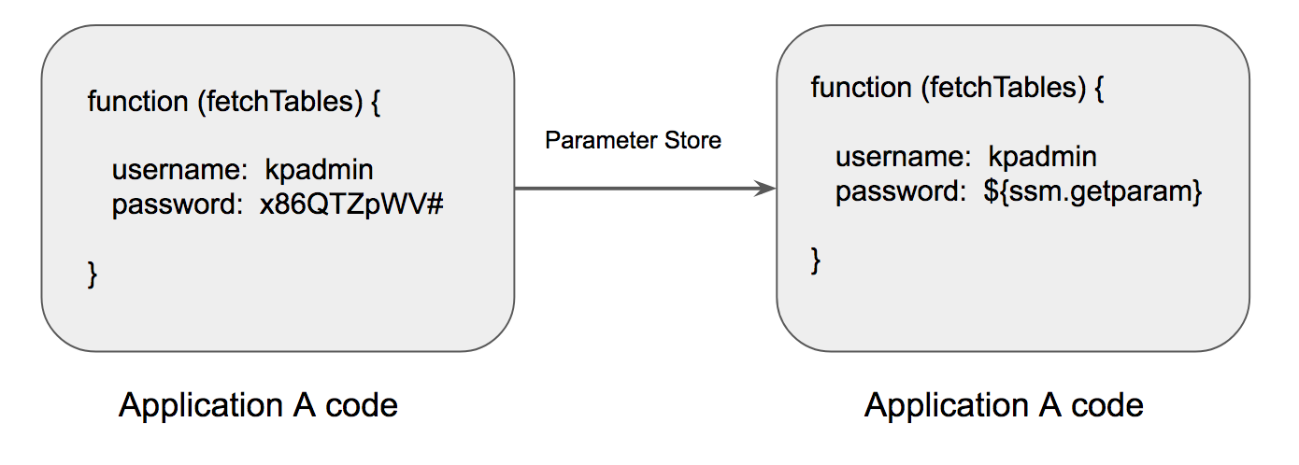
Getting the basics right
AWS Systems Manager Parameter Store provides centralized store to manage the configuration data, whether it is a plain-text data like database strings or even secrets such as passwords.
knowledge portal

Slide 126
Virtual Private Network
Let’s Route

Slide 127

VPN
VPN enables you to route traffic from yourself towards destination through itself.
Something similar to Proxy.
128.10.50.20
knowledge portal

Slide 128


Routing via VPN Server
128.10.50.20
54.20.30.56
knowledge portal

Slide 129

VPN use in Corporate Network
In Corporate environments, VPN is used to connect to instances in Private Subnet.
VPN Server resides in the Public Subnet and you route your traffic via VPN server to instances in Public Subnet.
knowledge portal

Slide 130
Cryptography
Time to Secret Out

Slide 131


Secret Code Word among Friends
knowledge portal

Slide 132

Designing simple encryption
knowledge portal

Slide 133

Designing simple encryption
Normal Password :- MYPASSWORD
Encrypted PWD :- KWNYQQUMPB
During War times, secret data were always sent in encrypted format.
knowledge portal

Slide 134

Symmetric Key Encryption
knowledge portal

Slide 135

Why Encryption ?
knowledge portal

Slide 136

After Encryption
knowledge portal

Slide 137
Designing simple encryption
Normal Password :- MYPASSWORD
Encrypted PWD :- KWNYQQUMPB
During War times, secret data were always sent in encrypted format.
knowledge portal

Slide 138

Algorithms are quite complex
knowledge portal

Slide 139


Encryption used during wars - Famous Enigma
knowledge portal

Slide 140

Good Movie to watch
It is a story about a British mathematician Alan trying to build a machine that would break the german encryption codes.
knowledge portal

Slide 141
Protocols
Communication

Slide 142


Humans have language to communicate
knowledge portal

Slide 143

2 computers want to talk to each other
knowledge portal

Slide 144

knowledge portal

Slide 145

knowledge portal

Slide 146
After Encryption
knowledge portal

Slide 147
Plain Text vs Encrypted Protocols
Communication

Slide 148

Various Protocols
There are various protocols actively used :
File Transfer Protocol (FTP)
Domain Name System Protocol ( DNS )
Transmission Control Protocol (TCP)
Secure File Transfer Protocol (SFTP)
Hyper Text Transfer Protocol (HTTP)
Internet Protocol (IP)
knowledge portal

Slide 149
knowledge portal

Slide 150
2 computers want to talk to each other
knowledge portal

Slide 151
After Encryption
knowledge portal

Slide 152
CloudHSM
Secure Storage

Slide 153


Storing Expensive House Hold Items
You have an expensive jewellery in your house and you are planning to go on a long vacation.
Where will you prefer to store the jewellery?
Cupboard
Bank Locker
knowledge portal

Slide 154


Storing Sensitive Digital Keys
You have sensitive encryption keys that needs to be stored
Where will you prefer to store the keys?
Special Security Devices
Notepad
knowledge portal

Slide 155
Special Security Device - HSM
A hardware security module (HSM) is a physical device that provides extra security for sensitive data
This type of device is used to provision cryptographic keys for critical functions such as encryption, decryption and authentication for the use of applications, identities and databases.
knowledge portal

Slide 156
Tamper Resistant
These devices are tamper resistant , that means if anyone tries to tamper, they will automatically delete the keys stored.
knowledge portal

Slide 157

CloudHSM
AWS CloudHSM is a cloud-based hardware security module (HSM).
With CloudHSM, you can manage your own encryption keys using FIPS 140-2 Level 3 validated HSMs.
Prior to this, company’s had to store HSM on-premise and if infrastructure was on AWS, there were lot of latency involved.

Slide 158
AWS KMS
Do things the right way

Slide 159

Basics of KMS
AWS KMS stands for AWS Key Management Service.
This service provides capability to encrypt and decrypt the data.
password: 1234
AWS KMS
User
#.@42312gsd
knowledge portal

Slide 160



Integration of KMS
AWS KMS also integrates with various AWS services like S3, DynamoDB, EBS and others.
S3 Bucket
AWS KMS
EBS
knowledge portal

Slide 161
AWS Control Tower
Agility and Governance

Slide 162


Challenges with Single AWS Account for Everything
Let us assume that organization has single AWS account
If privileged user’s credentials / keys are compromised, it is a high-risk for the entire organization.
Dev Environment
US Region
Complete Control
Stage Environment
Singapore Region
Attacker
Prod Environment
Mumbai Region

Slide 163
Better Architecture: Multi-Account
Better Architecture would be when each environment is isolated in individual set of isolated AWS accounts.
DEV AWS Account
Stage AWS Account
Prod AWS Account
knowledge portal

Slide 164
Accounts for Individual Team
Larger organizations prefer to give individual set of AWS account for each teams.
This can ensure business agility as teams are not blocked.
DEV - Payments
DEV - Coupons
DEV - Integration
knowledge portal

Slide 165
Challenge 1 - Identity Management
username1, password1
username2, password2
username3 password3
Dev AWS 1
Dev AWS 3
Identity AWS
Prod AWS 1
Dev AWS 2
Stage AWS
Security AWS
Prod AWS 2
knowledge portal

Slide 166
Solution 1 - Single Sign On
Single sign-on (SSO) is an authentication method that enables users to securely authenticate with multiple applications and websites by using just one set of credentials.
AWS SSO
Dev AWS 1
Dev AWS 3
Identity AWS
Prod AWS 1
Dev AWS 2
Stage AWS
Security AWS
Prod AWS 2
knowledge portal

Slide 167
Challenge 2 - Security Hardening
Enable AWS Config
AWS Organizations & SCP
Centralized Logging
Dev AWS 1
Dev AWS 3
Identity AWS
Prod AWS 1
Dev AWS 2
Stage AWS
Security AWS
Prod AWS 2
knowledge portal

Slide 168

Solution 2 - Security Automation
AWS CloudFormation StackSets allows you to create, update, or delete stacks across multiple accounts and Regions with a single operation
Enable AWS Config
Enable AWS CloudTrail
Enable AWS Guard Duty
knowledge portal

Slide 169




Centralized Logging
It is a best practice to store logs from all AWS accounts to a centralized AWS account.
CloudTrail
Account A
Logging Account
Config
Account B
knowledge portal

Slide 170
AWS Services Needed
While configuring from scratch, you will need to configure various services, some of these include:
AWS Organizations & SCP
Service Catalog
CloudFormation Stack Sets
AWS Config
CloudTrail
AWS Single Sign-On
AWS Directory Services
S3 + Bucket Policies
knowledge portal

Slide 171
AWS Control Tower
AWS Control Tower offers a straightforward way to set up and govern an AWS multi-account environment, following the best practices.
AWS Account 1
AWS Control Tower
AWS Account 2
AWS Organizations
AWS SSO
Best
Practices
CF StackSets
Config Aggregators
knowledge portal

Slide 172
AWS Outposts
AWS in On-Premise

Slide 173

Cloud is Servers Behind the Scenes
Cloud is basically set of Servers behind the scenes.
These servers reside in the AWS Datacenter.
Everything from Power, Cooling, Internet Connectivity, Physical Security is managed by AWS.
knowledge portal

Slide 174




Challenge 1: Latency
AWS DC

Slide 175
Possible Solution 1 - On-Premise Servers
AWS DC

Slide 176
Challenges with Hybrid Architecture
Different set of API’s to manage servers and services.
Automation is difficult.
Additional learning required.
knowledge portal

Slide 177

AWS Outposts
AWS Outposts is a fully managed service that offers the same AWS infrastructure, AWS services, APIs, and tools to virtually any datacenter, co-location space, or on-premises facility.
AWS Side
Customer Side
knowledge portal

Slide 178
Services that you can Run
With AWS Outposts, we can run wide variety of AWS services locally.
Some of these include:
Amazon EC2
Amazon EBS
S3
RDS
EKS
EMR
knowledge portal

Slide 179

Installation Step
knowledge portal

Slide 180
Use-Case for AWS Outposts
AWS Outposts can be used for wide-variety of use-cases.
Some of these include:
Low-Latency Requirements
Data Residency
Local Data Processing
knowledge portal

Slide 181
Amazon Cognito
Federation

Slide 182

Basics of Cognito
Amazon Cognito provides authentication, authorization, and user management service for your web and mobile apps.
knowledge portal

Slide 183
Sample Use-Case
Alice is a mobile developer in a start-up organization. They have begun with mobile wallet system, and there are specific requirements as follows:
Users should be able to sign-up with new credentials.
User should be able to sign-in with social platforms like FB, Twitter, Google.
There should be a post sign-up process (one-time password) for verification.
Multi-Factor authentication should be present.
Account recovery feature should be present.
In-Short: Build a Complete Authentication & Authorization System
knowledge portal

Slide 184
Amazon Cognito
At a high level, there are two major features under Amazon Cognito
i) User Pools
ii) Identity Pools
Cognito user pool takes care of the entire authentication, authorization process .
Identity pool provides the functionality of federation for users in user pools.
knowledge portal

Slide 185
Identity Pool
Cognito Identity pools also referred to as AWS Cognito Federated Identities allows developers to authorize the users of the application to use various AWS services.
Use-Case:
We have a quiz based mobile application. At the end of quiz, user’s results should be stored in the DynamoDB table.
If we hard-code the access/secret keys, chances of reverse engineering are high.
knowledge portal

Slide 186

Cognito Identity Pool Working - NO
knowledge portal

Slide 187

User Pool vs Identity Pool - NO
The Cognito Identity pool then takes these identities and federates them and then can give secure access to the AWS services regardless of where the user comes from.
knowledge portal

Slide 188
AWS GuardDuty
Let’s start Rolling !

Slide 189

Understanding GuardDuty
AWS Guard Duty is a threat intelligence service by AWS which monitors for malicious behavior to help customers protect their AWS workloads.
knowledge portal

Slide 190

GuardDuty Findings
knowledge portal

Slide 191
Important Pointers
Guard Duty will only monitor the Route53 for DNS Logs.
Lot of organizations makes use of Active Directory DNS. The logs from these servers will not be monitored.
knowledge portal

Slide 192
Amazon Detective
Threat Detection Service

Slide 193

Basics of Amazon Detective
Amazon Detective makes it easy to investigate, analyze, and quickly identify the root cause of potential security issues or suspicious activities.
knowledge portal

Slide 194
Important Note
Amazon Detective is a threat detection service that continuously monitors for malicious activity and unauthorized behavior to protect your AWS accounts and workloads.
Amazon Detective enables you to analyze and visualize security data from your AWS CloudTrail logs, VPC Flow logs, and Amazon GuardDuty findings.
Amazon Detective pricing is based on the volume of data ingested from AWS CloudTrail logs, Amazon VPC Flow Logs, and Amazon GuardDuty findings. You are charged per Gigabyte (GB) ingested per account/region/month
knowledge portal

Slide 195
AWS Secrets Manager
Back to Security!

Slide 196
Getting Started
AWS Secrets Manager enables customers to rotate, manage and retrieve database credentials, API keys and other secrets throughout their lifecycle.
Lots of developers store secrets as plain text or DevOps team adds them as an environmental variable. This creates security risks.
Compliance like PCI DSS requires secrets must be rotated and audit on who does what with secrets.
knowledge portal

Slide 197
Key Features of Secrets Manager
Built-In integration for rotating MySQL, PostgreSQL and Aurora on RDS.
Use versisoning so applications do not break when secrets are rotated.
Fine grained access control to control who has access to secrets with help of IAM and Resource based policies.
knowledge portal

Slide 198
Important Points for Exams
Cloud HSM is Single Tenanted ( Single Physical Device only for you )
It must be used within a VPC.
We can integrate Cloud HSM with RedShift & RDS for Oracle.
For fault tolerance, we will need to build cluster of 2 Cloud HSM.
AWS uses Safenet Luna SA HSM appliance for Cloud HSM.
They are FIPS validated.
It generally has 2 partitions, one for AWS to monitor and second is cryptographic partition which you have access to and has stored keys.
knowledge portal

Slide 199
AWS Certificate Manager
Certificates Again :)

Slide 200


Earlier Approach
I have a website and I need to use HTTPS. There are two ways, self-signed certificate and the CA signed certificate.
Self Signed Certificate
CA Signed Certificate
knowledge portal

Slide 201


Generating Certificates
To generate a certificate for your domain, you will have to go to a Certificate Authority and after required level of validation, you would be issued a certificate.
Generate certificate for kplabs.in
User
Validated for 1 year.
Certificate Authority
cert
private key
knowledge portal

Slide 202


AWS Certificate Manager
AWS Certificate Manager (ACM) handles the complexity of creating, storing, and renewing public and private SSL/TLS X.509 certificates and keys that protect your AWS websites and applications.
Generate certificate for kplabs.in
Cert Integrated
User
Integrate certificate with ELB
ACM
Load Balancer
knowledge portal

Slide 203


Join us in our Adventure
kplabs.in/twitter
Be Awesome
kplabs.in/linkedin
instructors@kplabs.in

